Slide 1
Progress Report
2024.3.5
Yida Zhang

Slide 2
Outline
Feature Selection Layer Experiments
Plot prediction trend of selected features
Test on the large-scale dataset
Test on the SCG features
Hypertension Classification
2/3/4/8-class classification
VTCN regression
Possible method to improve the accuracy

Slide 3
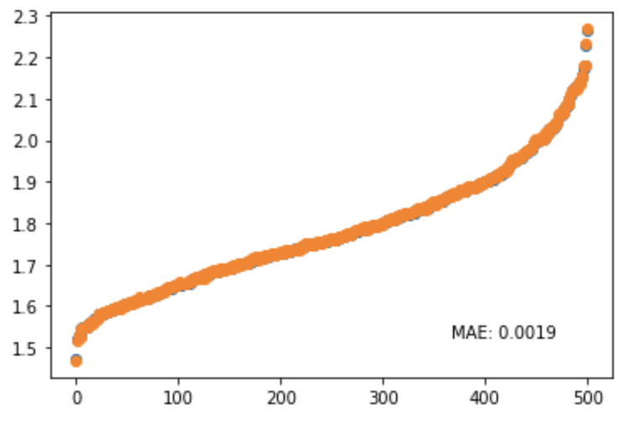
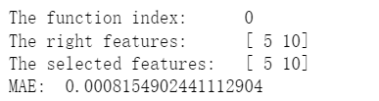
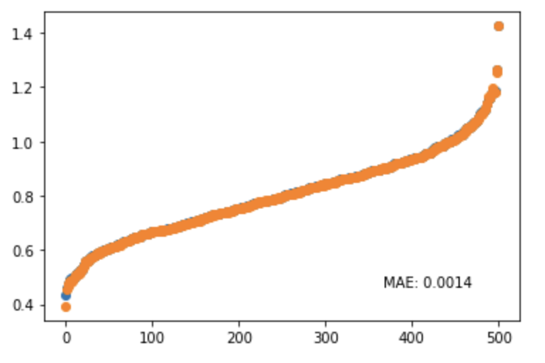
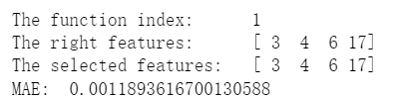
Label: Blue
Prediction: Orange
Notes:
横纵轴代表什么

Slide 4
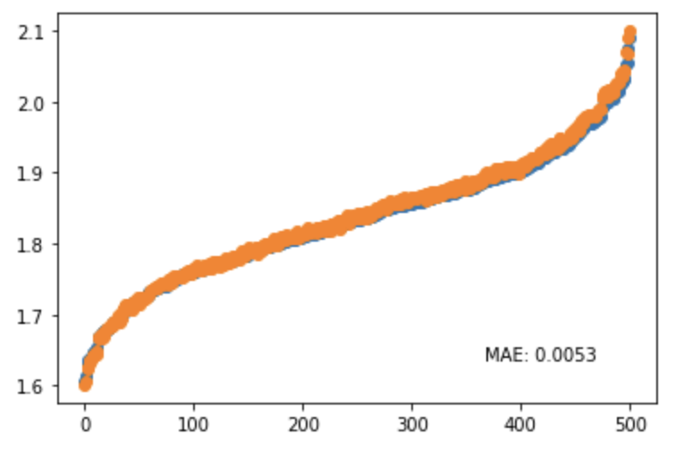
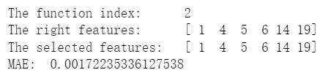
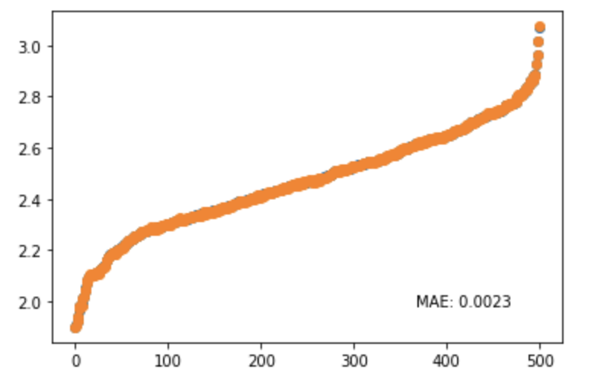
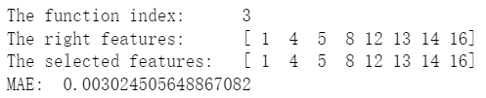
Label: Blue
Prediction: Orange

Slide 5
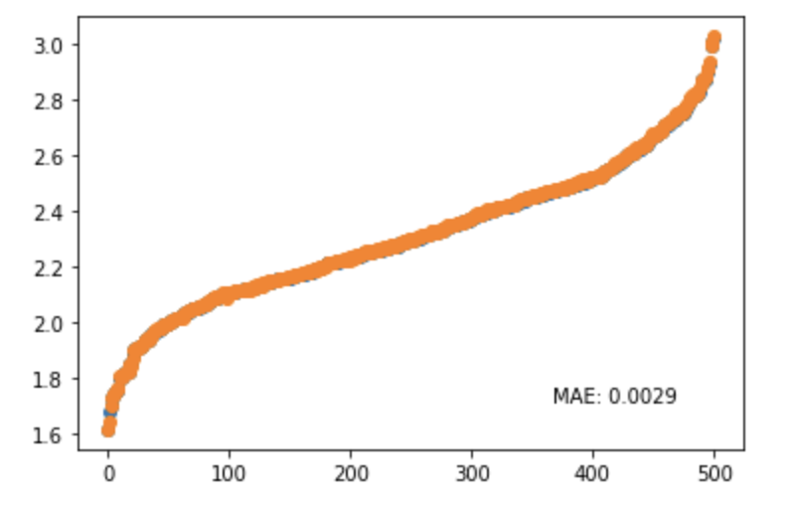
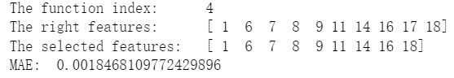
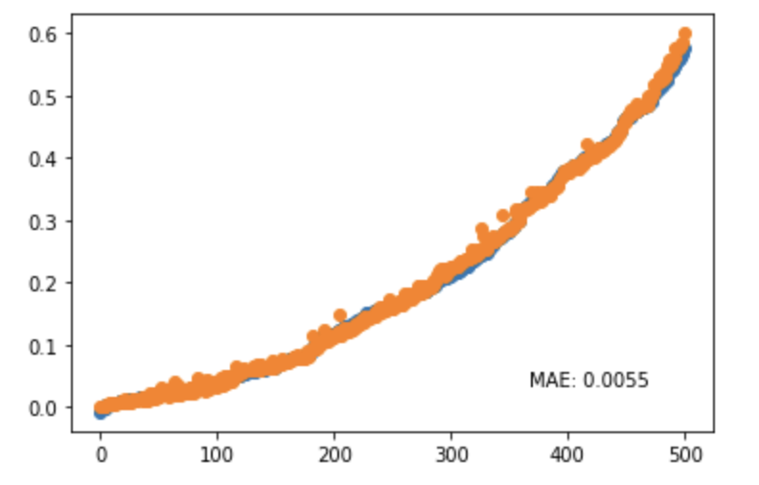
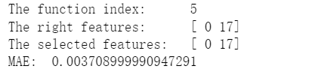
Label: Blue
Prediction: Orange

Slide 6

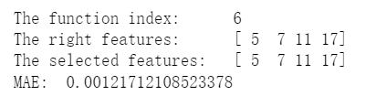
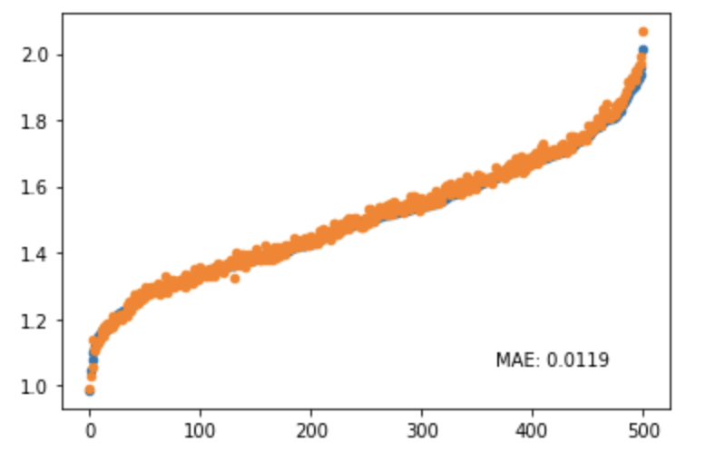
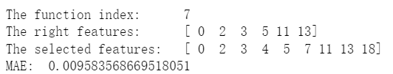
Label: Blue
Prediction: Orange

Slide 7
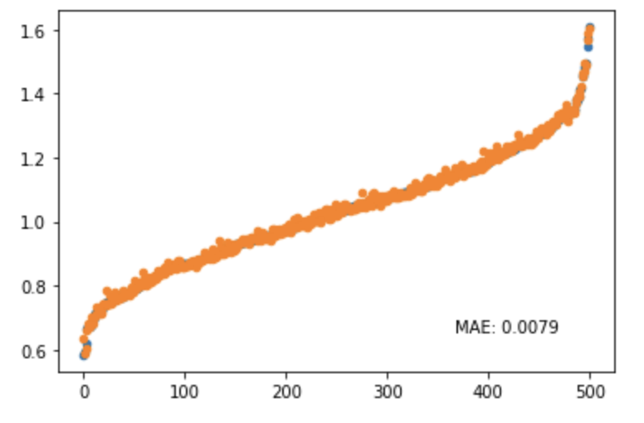
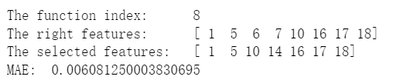
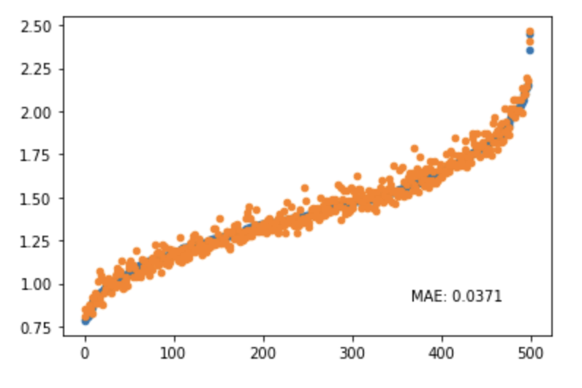
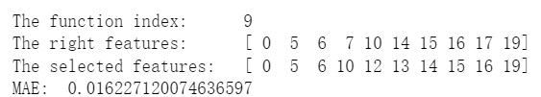
Label: Blue
Prediction: Orange

Slide 8
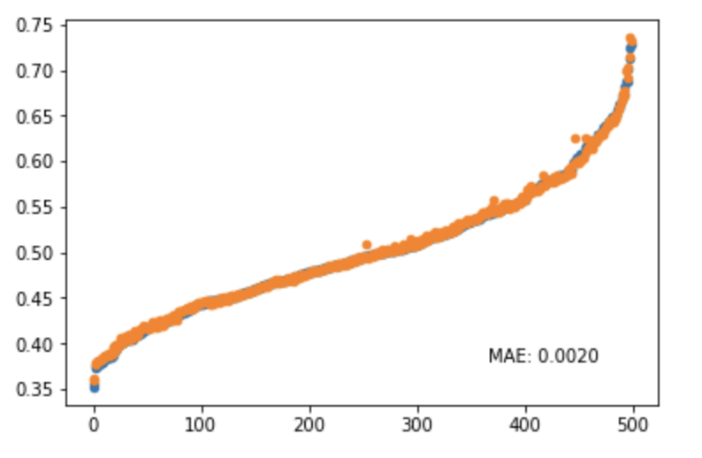
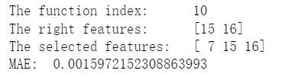
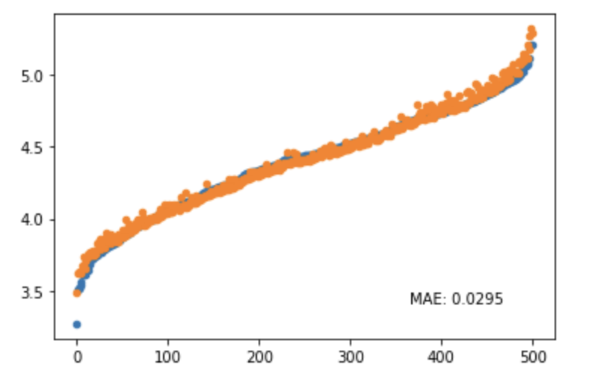
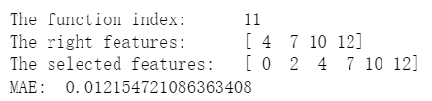
Label: Blue
Prediction: Orange

Slide 9
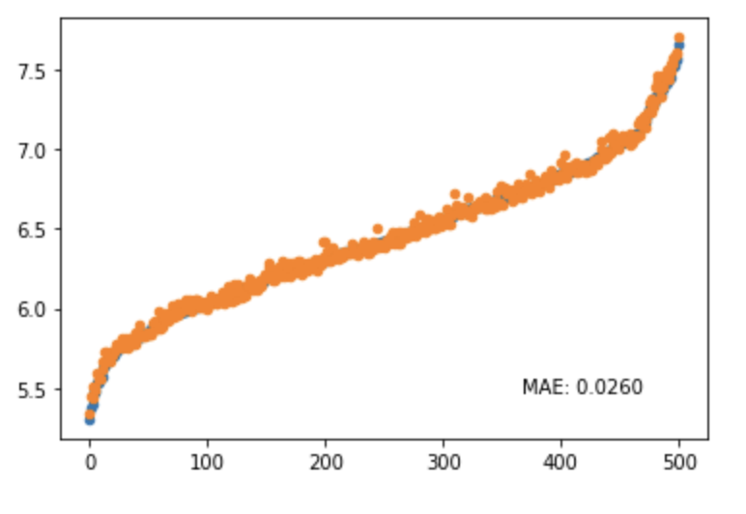
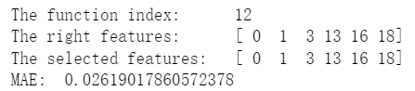
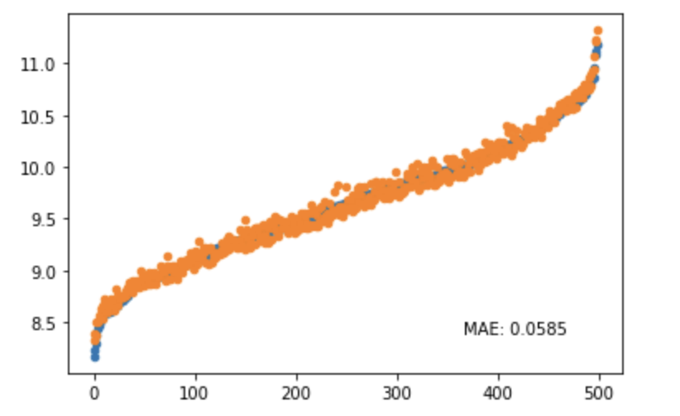
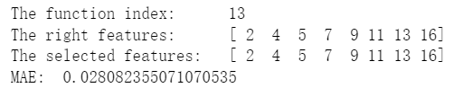
Label: Blue
Prediction: Orange

Slide 10
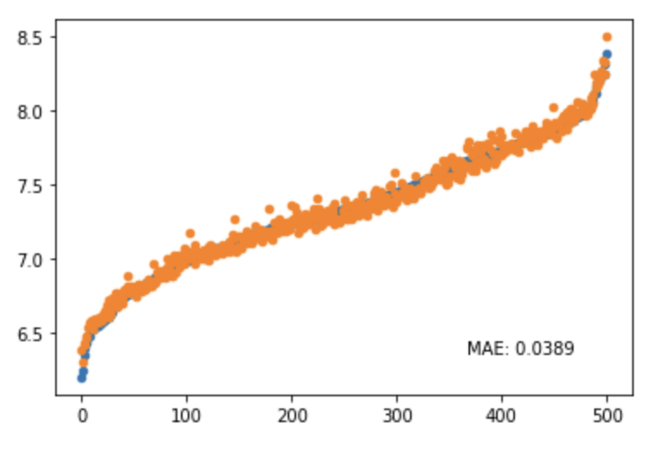
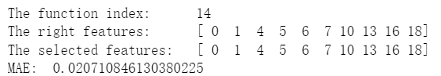
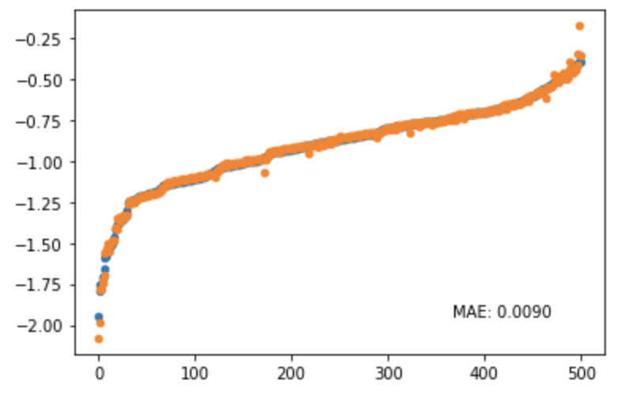
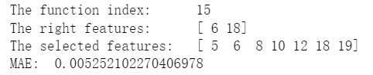
Label: Blue
Prediction: Orange

Slide 11
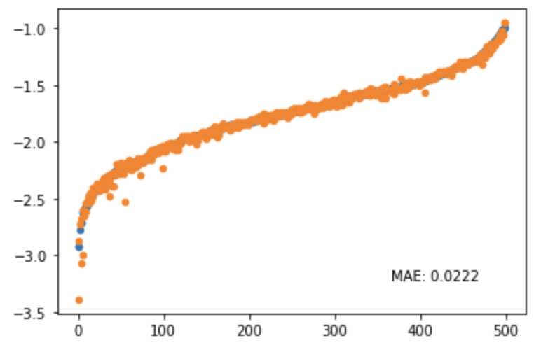
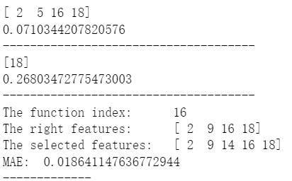
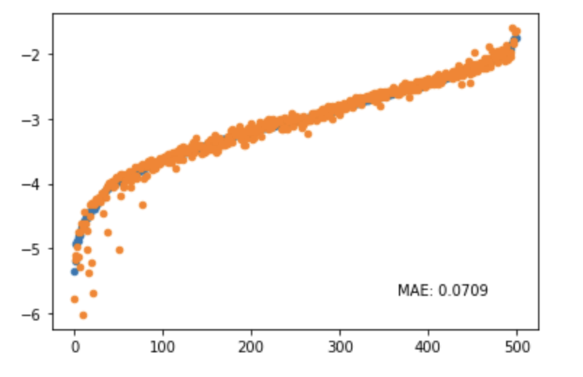
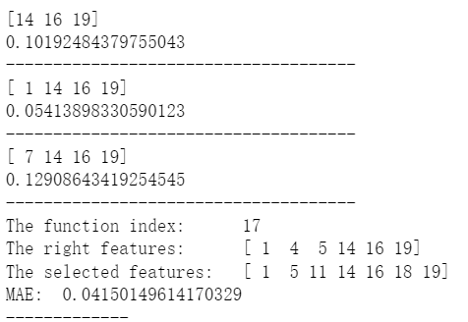
Label: Blue
Prediction: Orange

Slide 12
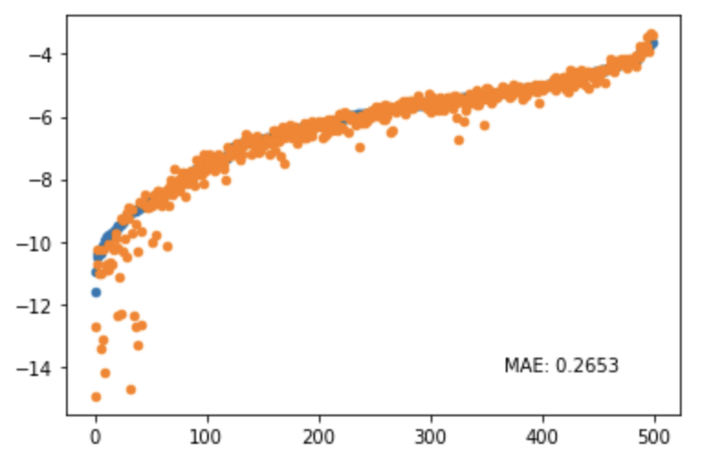
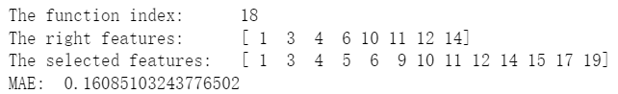
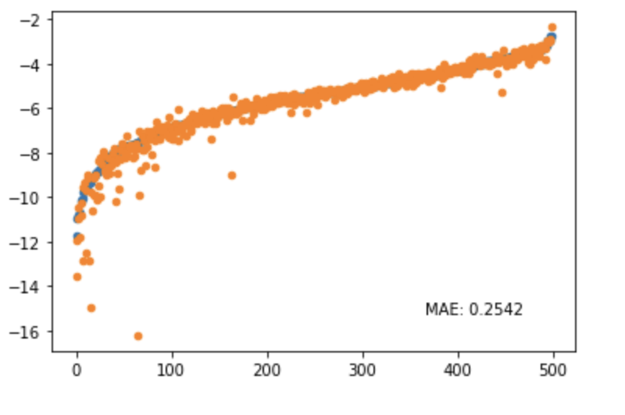
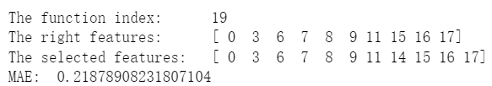
Label: Blue
Prediction: Orange

Slide 13
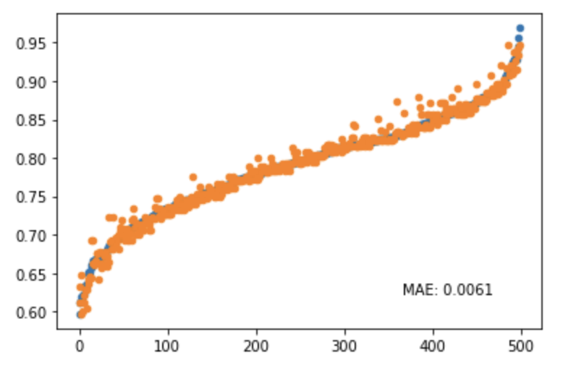
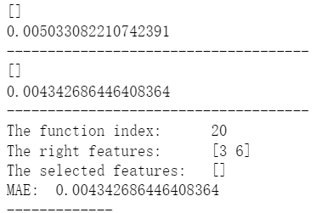
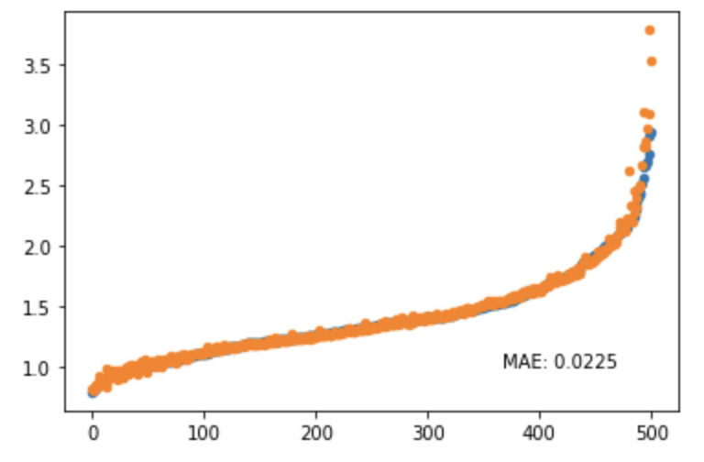
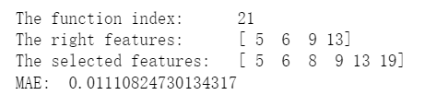
Label: Blue
Prediction: Orange

Slide 14
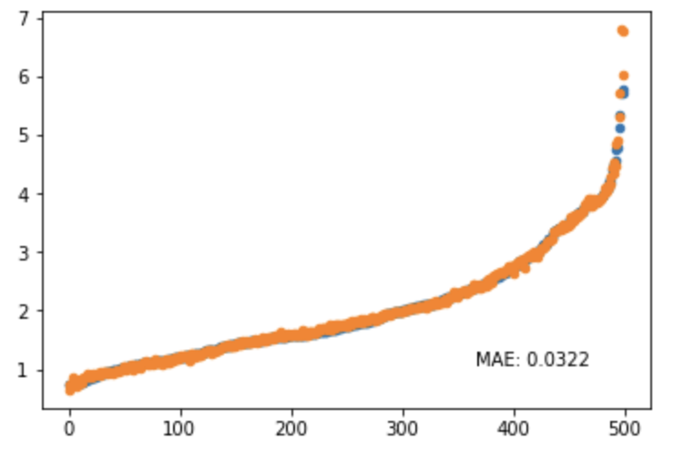
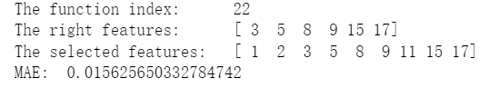
Label: Blue
Prediction: Orange

Slide 15
Test on the large-scale dataset
Experiment Setup
Select 5 right features in 50 features
Select 5 right features in 100 features
Select 5 right features in 500 features
Select 5 right features in 1000 features
Model: Feature Selection Layer + MLP(4)
Learning Rate: 0.01
Optimizer: Adam
Function: Linear, Polynomial, Exponential
Select 25 right features in 50 features
Select 50 right features in 100 features
Select 250 right features in 500 features
Select 500 right features in 1000 features

Slide 16
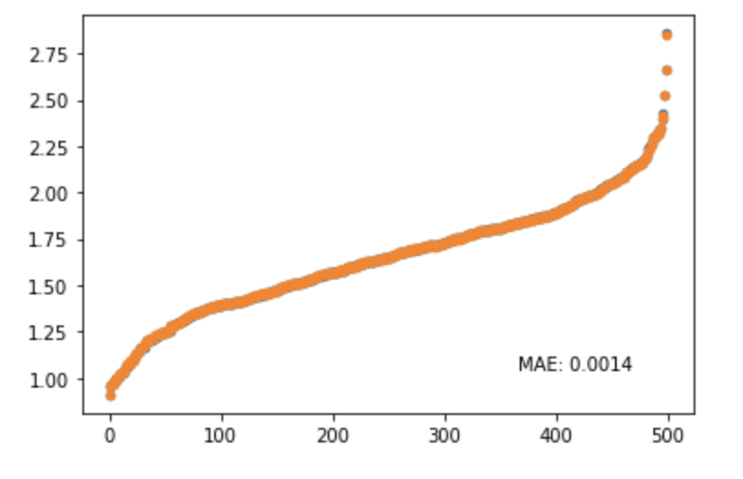
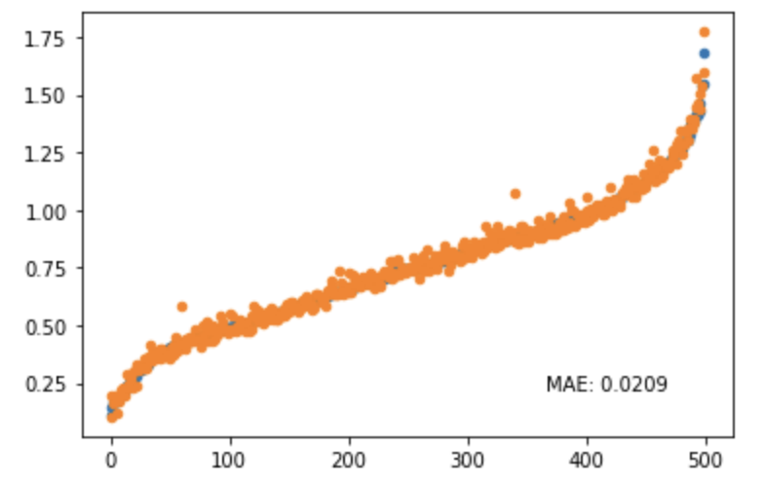
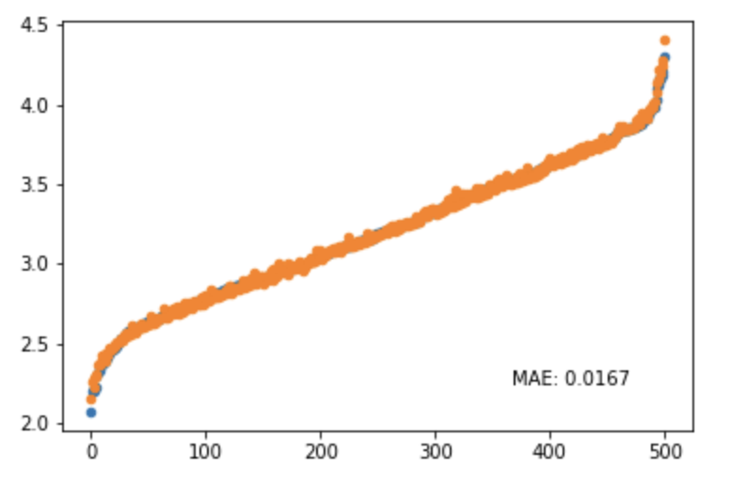
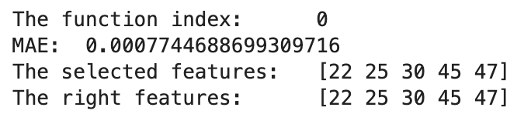
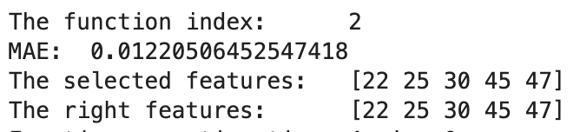

Test on the large-scale dataset (5-50)

Slide 17






Test on the large-scale dataset (5-100)

Slide 18






Test on the large-scale dataset (5-500)

Slide 19






Test on the large-scale dataset (5-1000)

Slide 20






Test on the large-scale dataset (25-50)

Slide 21






Test on the large-scale dataset (50-100)

Slide 22





Test on the large-scale dataset (150-500, 500-1000)

Slide 23
Conclusion
Feature Selection Layer can work on the situation that:
select small number of features among big number of features.
It can’t select big number of features.

Slide 24


Test on the TSFEL features

Slide 25
2/3/4/8-class classification
 | 2 | 3 | 4 | 8
Accuracy | 0.773 | 0.457 | 0.285 | 0.143
F1 | 0.823 | 0.497 | 0.170 | 0.094

Slide 26


VTCN regression
Hypertension Classification Dataset
Synthetic SCG Dataset

Slide 27
Questions:
1. Does the feature selection layer meet the common requirements?
2. Why 2-class classification’s accuracy is only 77%

